Slide 1
Flux & React
Web Application Development

Slide 2
Introduction to Web Development
HyperText Markup Language (HTML)
The standard markup language used to create web pages
Consists of tags enclosed in angle brackets: <html>something</html>
Cascading Style Sheets (CSS)
The standard style sheet language used for describing the look and formatting of a document written in a markup language, usually HTML.
Uses a JSON-like structure to define classes and attributes for each HTML tag
JavaScript (JS)
Also known as ECMAScript
Programming language of HTML and the Web
Enables many more dynamic features of websites and web applications

Slide 3

React
A JavaScript library for building user interfaces

Slide 4
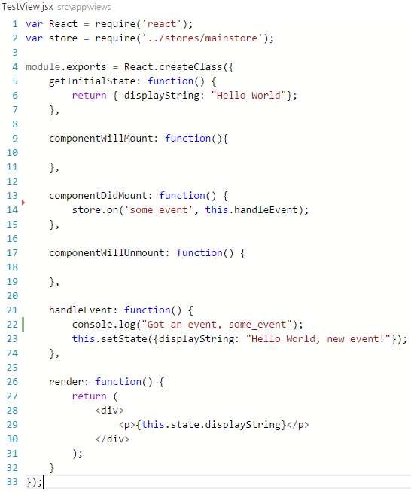
React Overview
Just the User Interface
Handles the V in the MVC design pattern
Simple Components
Each react component handles one thing
Usually written in JSX format
Allows for XML/HTML-like syntax directly in the JavaScript code
Translates directly into JavaScript
Can be run directly in a standard web browser with no additional libraries required

Slide 5
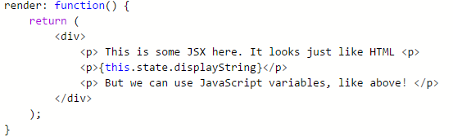
Intro to JSX
JSX is a JavaScript syntax extension that looks similar to XML/HTML
Offers a concise and familiar syntax for defining components with optional attributes and state
It's more familiar for casual developers such as designers
Each React component is displayed through its render function. This function returns some JSX that defines how the component will display on the page.

Slide 6
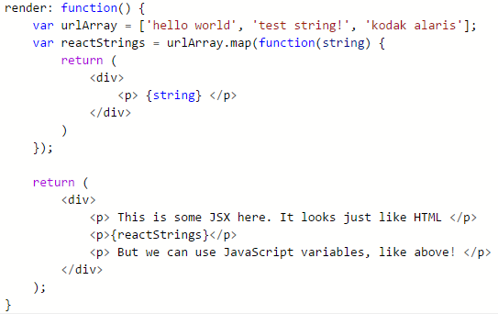
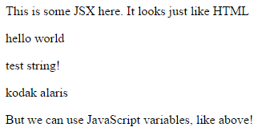
Intro to JSX
This Render function and some helper JavaScript variables lets us do some really useful things!
Dynamically creating a number of React components from values in a JavaScript array

Slide 7
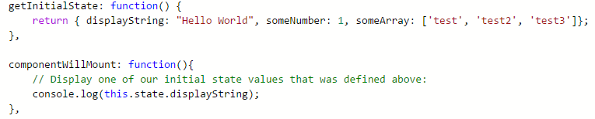
React Component State
More complex React components can have some state information that helps them decide how they should render and display.
This could include data like our little example array from before
If the state changes it will trigger a call to the render method so the component can be updated.
Some initial state can be defined in a component by overriding the getInitialState function

Slide 8
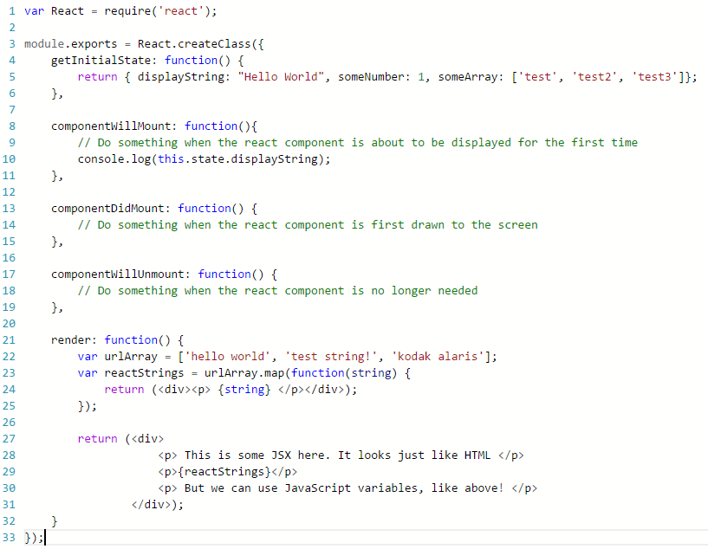

Slide 9

Flux
An architecture for building client-side web applications

Slide 10
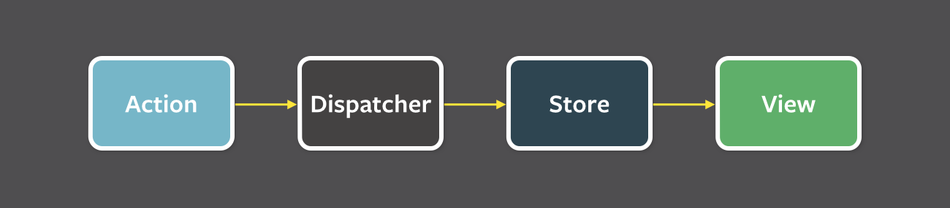
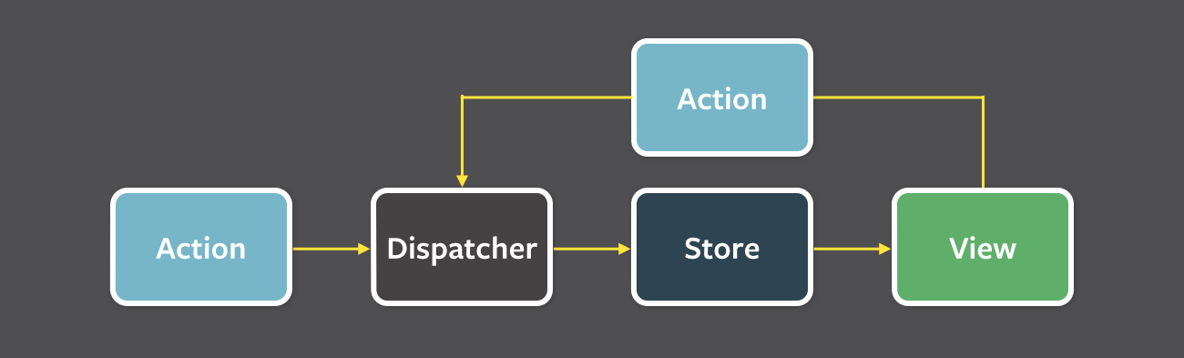
Flux Overview
Data in a Flux application flows in a single direction:
NOT a code library.
This is just a design pattern
Flux applications have three major parts
Dispatcher
Stores
Views (React Components)
Structure and Data Flow
Unidirectional data flow is central to the Flux pattern
The dispatcher, stores and views are independent nodes with distinct inputs and outputs
The views may cause a new action response to user input

Slide 11
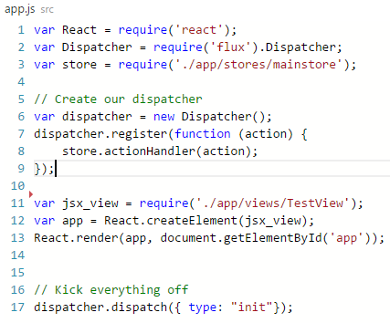
Flux: Dispatcher
The dispatcher is the central hub that manages all data flow in a Flux application
Has no real intelligence of its own
It is a simple mechanism for distributing the actions to the stores
Each store registers itself and provides a callback
All stores in the application receive the action via the callbacks and can choose to act on them
Facebook, the creators of Flux, provide code for an example Dispatcher to get started. This is seen in the require(‘flux’).Dispatcher statement in the code to the right.

Slide 12
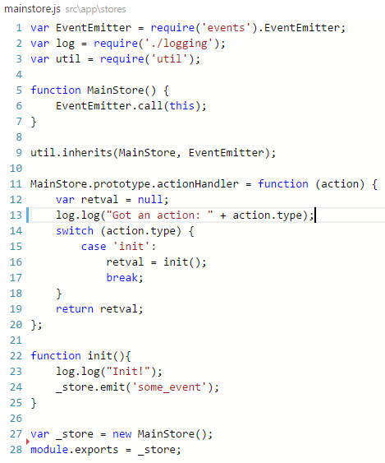
Flux: Stores
Stores contain the application state and logic
Similar to a model in a traditional MVC
Registers itself with the dispatcher and provides it with a callback
Contains a switch statement that can decide what to do with various actions that are dispatched by the Dispatcher

